Slide 1
Scale Up with Python
Uncoiling Python's Basics
risk control

Slide 2
Outline
What is Python?
Let’s get coding!
Alright, let’s really get coding!
What is programming?
Where does Python fit in?
How do we use it on our computer?
Python specifics:
Notebooks
Types
Variables and names
Packages
Conditional statements
Loops
Functions
Class
Break
How have we used this at Acin?
What can we use this for at Acin?
Mini-task
Questions

Slide 3
What is Python?

Slide 4
What is Programming?

Slide 5
Drawing Distinctions
Computer
Program
Programming Language
Machine that takes inputs and calculates outputs.
Personal computer:
Hardware – runs ‘computations’
OS – used to manage software and user interaction with the hardware
Information stored and processed as binary.
An OS contains several programs.
Anything from a full-fledged application to single script.
Set of operations/instructions bundled into a useful package.
Potentially built using multiple programming languages.
A tool we use to provide instructions to the computer hardware for execution.
Human readable version of binary code.
Each has strengths and weaknesses - they are suited to different tasks.
‘Paradigms’ are used to describe language properties.

Slide 6
For what exactly?
General Purpose
Domain Specific
C, C++, C#
Java, Javascript
Julia
Ocaml
Python
Ruby
Data Management: SQL (and variants), MQL
Document: HTML, LaTex
Shell: Bash, ZSH
Numerical Computation: R, MATLAB, SAS
Microsoft Applications: VBA

Slide 7
Levelling Up
High level vs low level programming languages
Python
Ruby
Ocaml
Julia
Java
C++/ C#
C
Assembly
Machine language
Binary

Slide 8
Where does Python fit in?

Slide 9
Python
An introduction
Paradigm
High Level – easy to understand English syntax, easy to understand
Multi-Paradigm:
Object Oriented – code structured around abstract ‘objects’ that contain data and associated methods
Functional – can explicitly write process as series of reusable functions and execute appropriately
Procedural – can explicitly write process as set of explicit step-by-step instructions
Free and open source
Code execution formatting dependant (clean).
Built on top of C
Currently v3 but lots of v2 (depreciated) code exists.

Slide 10
Python
Everybody seems to be using it?
Articles about use/direction of travel
Flexible/High level
Easy ML integration
In particular – deep learning (PyTorch/Tensorflow)

Slide 11
Python
Notable use cases
Varied famous python projects (a little bit of it everywhere…)

Slide 12
How can we start using it?

Slide 13
Python
Where is it?

Slide 14
Python
How can I use it?
Split into IDE/terminal (compiled)

Slide 15
Python
How can I use it?
Example excel to python tie-in (https://www.theverge.com/2023/8/22/23841167/microsoft-excel-python-integration-support)

Slide 16
Let’s get coding!

Slide 23
Title goes here.

Slide 24
Title goes here.

Slide 25
Section title goes here.

Slide 26
Section title goes here.

Slide 27
Generic templated slides

Slide 28
Headline goes here Headline 2nd line goes here
Subtitle goes here
Pore vit apis aut fugit et acipis sitatet modi acilita nusapienis sit illabor aliqui blab in con cupitatem hariore, voloreictas dolorundion ne vendaepe con ernatemporat fugitat di nobis maximin et aspe consequ aspellit ut eaqui nobis si dolorum quidiam fugiti tem fugia cus.
Consequ aspellit ut eaqui nobis si dolorum quidiam fugiti tem fugia cus.
Consequ aspellit ut eaqui nobis si dolorum
Consequ aspellit ut eaqui nobis si dolorum quidiam fugiti tem fugia cus.
Sub bullet style
Sub bullet style
Sub bullet style

Slide 29
Headline goes here Headline 2nd line goes here
Subtitle goes here
Subtitle goes here
Pore vit apis aut fugit et acipis sitatet modi acilita nusapienis sit illabor aliqui blab in con cupitatem hariore, voloreictas dolorundion ne vendaepe con ernatemporat fugitat di nobis maximin et aspe consequ aspellit ut eaqui nobis si dolorum quidiam fugiti tem fugia cus.
Consequ aspellit ut eaqui nobis si dolorum quidiam fugiti tem fugia cus.
Consequ aspellit ut eaqui nobis si dolorum
Consequ aspellit ut eaqui nobis si dolorum
Pore vit apis aut fugit et acipis sitatet modi acilita nusapienis sit illabor aliqui blab in con cupitatem hariore, voloreictas dolorundion ne vendaepe con ernatemporat fugitat di nobis maximin et aspe consequ aspellit ut eaqui nobis si dolorum quidiam fugiti tem fugia cus.
Consequ aspellit ut eaqui nobis si dolorum quidiam fugiti tem fugia cus.
Consequ aspellit ut eaqui nobis si dolorum
Consequ aspellit ut eaqui nobis si dolorum

Slide 30
Headline goes here Headline 2nd line goes here
Subtitle goes here
Subtitle goes here
Subtitle goes here
Pore vit apis aut fugit et acipis sitatet modi acilita nusapienis sit illabor aliqui blab in con cupitatem hariore, voloreictas dolorundion ne vendaepe con ernatemporat fugitat di nobis maximin et aspe consequ aspellit ut eaqui nobis si dolorum fugiti tem fugia cus.
Pore vit apis aut fugit et acipis sitatet modi acilita nusapienis sit illabor aliqui blab in con cupitatem hariore, voloreictas dolorundion ne vendaepe con ernatemporat fugitat di nobis maximin et aspe consequ aspellit ut eaqui nobis si dolorum fugiti tem fugia cus.
Pore vit apis aut fugit et acipis sitatet modi acilita nusapienis sit illabor aliqui blab in con cupitatem hariore, voloreictas dolorundion ne vendaepe con ernatemporat fugitat di nobis maximin et aspe consequ aspellit ut eaqui nobis si dolorum fugiti tem fugia cus.

Slide 31
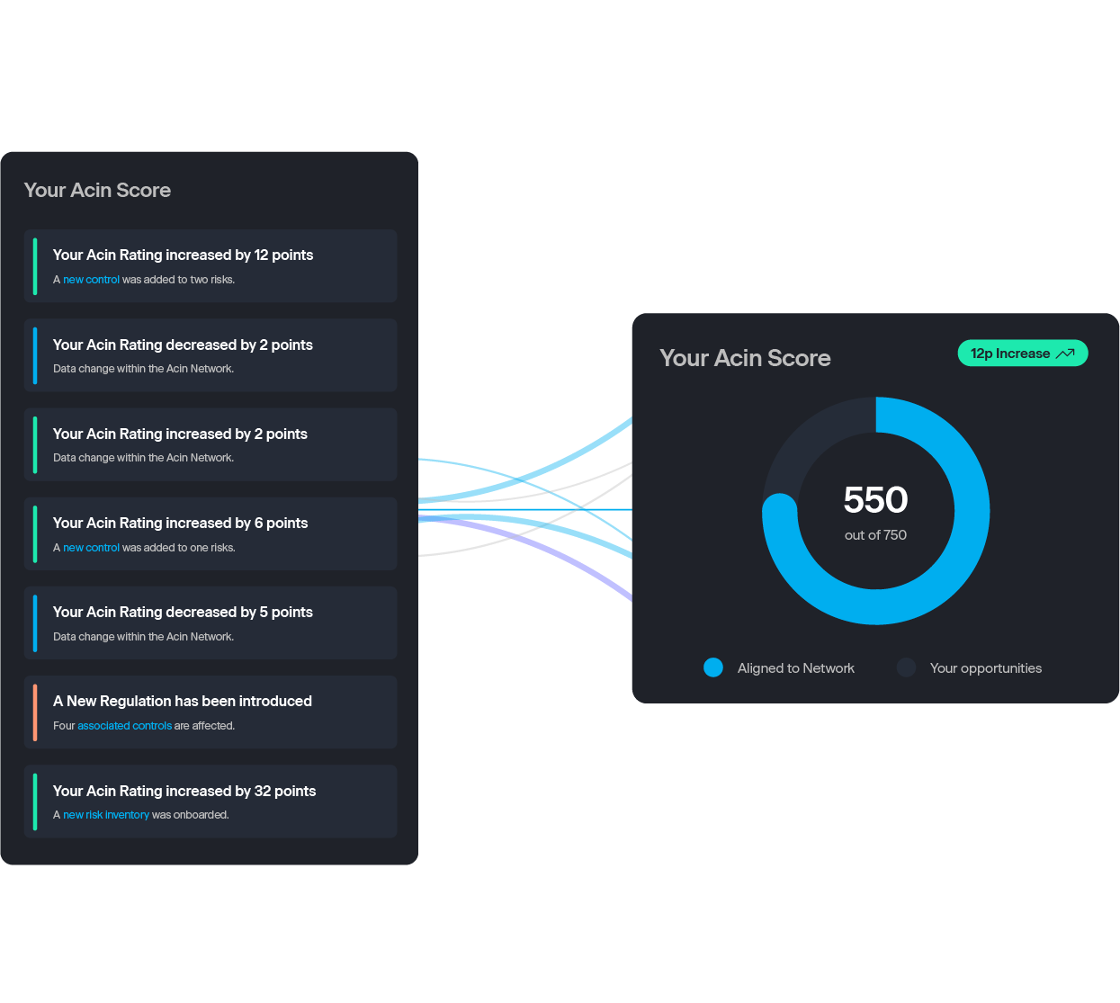
Headline goes here Headline 2nd line goes here
Subtitle goes here
Pore vit apis aut fugit et acipis sitatet modi acilita nusapienis sit illabor aliqui blab in con cupitatem hariore, voloreictas dolorundion ne vendaepe con ernatemporat fugitat di nobis maximin et aspe consequ aspellit ut eaqui nobis si dolorum quidiam fugiti tem fugia cus.
Consequ aspellit ut eaqui nobis si dolorum quidiam fugiti tem fugia cus.
Consequ aspellit ut eaqui nobis si dolorum
Consequ aspellit ut eaqui nobis si dolorum

Slide 32
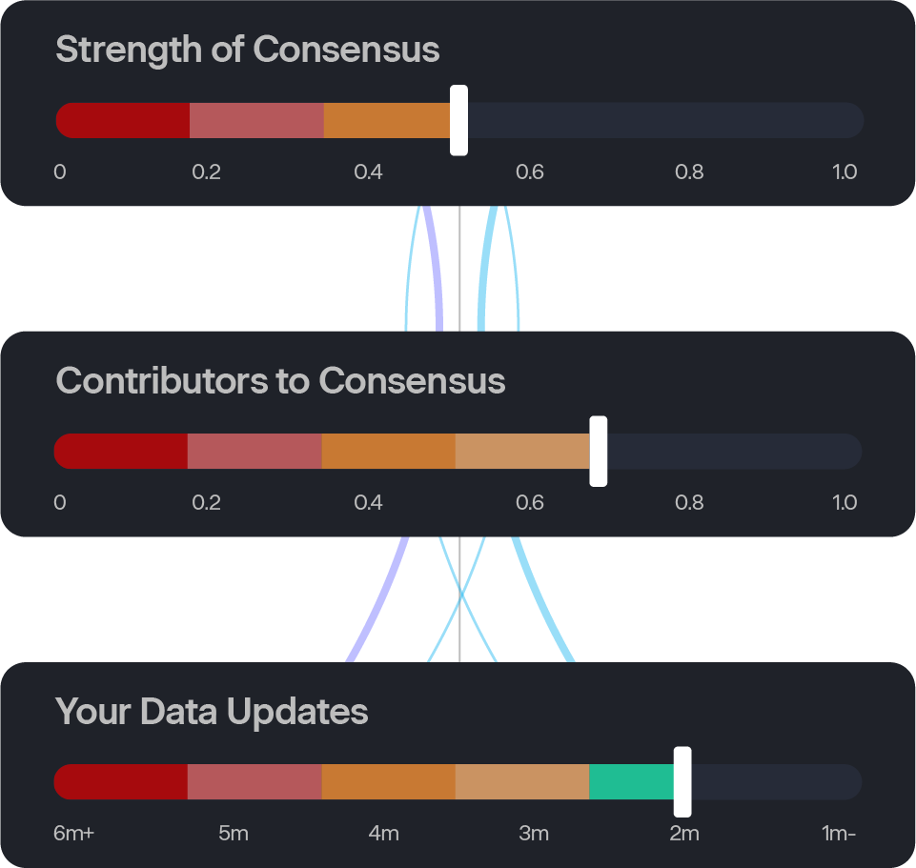
Headline goes here Headline 2nd line goes here
Subtitle goes here
Pore vit apis aut fugit et acipis sitatet modi acilita nusapienis sit illabor aliqui blab in con cupitatem hariore, voloreictas dolorundion ne vendaepe con ernatemporat fugitat di nobis maximin et aspe consequ aspellit ut eaqui nobis si dolorum quidiam fugiti tem fugia cus.
Consequ aspellit ut eaqui nobis si dolorum quidiam fugiti tem fugia cus.
Consequ aspellit ut eaqui nobis si dolorum
Consequ aspellit ut eaqui nobis si dolorum

Slide 33

Headline goes here Headline 2nd line goes here
Subtitle goes here
Pore vit apis aut fugit et acipis sitatet modi acilita nusapienis sit illabor aliqui blab in con cupitatem hariore, voloreictas dolorundion ne vendaepe con ernatemporat fugitat di nobis maximin et aspe consequ aspellit ut eaqui nobis si dolorum quidiam fugiti tem fugia cus.
Consequ aspellit ut eaqui nobis si dolorum quidiam fugiti tem fugia cus.
Consequ aspellit ut eaqui nobis si dolorum
Consequ aspellit ut eaqui nobis si dolorum
PLACEHOLDER IMAGE

Slide 34
Headline goes here Headline 2nd line goes here
Subtitle goes here
Pore vit apis aut fugit et acipis sitatet modi acilita nusapienis sit illabor aliqui blab in con cupitatem hariore, voloreictas dolorundion ne vendaepe con ernatemporat fugitat di nobis maximin et aspe consequ aspellit ut eaqui nobis si dolorum quidiam fugiti tem fugia cus.
Consequ aspellit ut eaqui nobis si dolorum quidiam fugiti tem fugia cus.
Consequ aspellit ut eaqui nobis si dolorum
Consequ aspellit ut eaqui nobis si dolorum

Slide 35

Headline goes here Headline 2nd line goes here
Subtitle goes here
Pore vit apis aut fugit et acipis sitatet modi acilita nusapienis sit illabor aliqui blab in con cupitatem hariore, voloreictas dolorundion ne vendaepe con ernatemporat fugitat di nobis maximin et aspe consequ aspellit ut eaqui nobis si dolorum quidiam fugiti tem fugia cus.
Consequ aspellit ut eaqui nobis si dolorum quidiam fugiti tem fugia cus.
Consequ aspellit ut eaqui nobis si dolorum
Consequ aspellit ut eaqui nobis si dolorum
PLACEHOLDER IMAGE

Slide 36
Headline goes here Headline 2nd line goes here
Subtitle goes here
Pore vit apis aut fugit et acipis sitatet modi acilita nusapienis sit illabor aliqui blab in con cupitatem hariore, voloreictas dolorundion ne vendaepe con ernatemporat fugitat di nobis maximin et aspe consequ aspellit ut eaqui nobis si dolorum quidiam fugiti tem fugia cus.
Consequ aspellit ut eaqui nobis si dolorum quidiam fugiti tem fugia cus.
Consequ aspellit ut eaqui nobis si dolorum
Consequ aspellit ut eaqui nobis si dolorum

Slide 37




Headline goes here Headline 2nd line goes here
Subtitle goes here
Subtitle goes here
Subtitle goes here
Subtitle goes here
Pore vit apis aut fugit et acipis si tatet modi acilita nusapienis sit illabor aliqui blab in con cupitatem hariore, voloreictas dolorundion.
Pore vit apis aut fugit et acipis si tatet modi acilita nusapienis sit illabor aliqui blab in con cupitatem hariore, voloreictas dolorundion.
Pore vit apis aut fugit et acipis si tatet modi acilita nusapienis sit illabor aliqui blab in con cupitatem hariore, voloreictas dolorundion.
Pore vit apis aut fugit et acipis si tatet modi acilita nusapienis sit illabor aliqui blab in con cupitatem hariore, voloreictas dolorundion.
Pore vit apis aut fugit et acipis si tatet modi acilita nusapienis sit illabor aliqui blab in con cupitatem hariore, voloreictas dolorundion.

Slide 38
Section title goes here.

Slide 39
Cullam solorerum ex eatiasi net ad eaquunt verorior moll ore peribusante nusam unt por maioren isitium hil il eum.
62%

Slide 40
Stand alone slides

Slide 41


Operational risk control statistics
43% change
6% missing
$23.5bn
gross loss annually
28% proliferated, imprecise

Slide 42


Unprecedented risk control challenges
Pressured on all sides Regulators, Audit, Board and business
Maintenance and clean up
Perpetual, manual and time consuming
Op Risk events
Money, time and resource
Pressured on all sides Regulators, Audit, Board and business
Proliferation Disconnected and unevenly documented
Three Lines of Defence
Not on the same page

Slide 43



Risk Control Diagnostics helps the 3 Lines of Defence
Lines of defence
1LoD
2LoD
3LoD
Board
Risk diagnostics
RCSA
Monitoring
& testing
Governance
& reporting
Scenario
analysis
Regulator
engagement
Read
across
Horizon
scanning

Slide 44
Acin accelerates risk control maturity at every level
Dynamic
Complete
Standardized
and Simplified
Emerging
Ongoing monitoring approach
Performance data diagnostics
Loss data diagnostics
Continual opportunity realization
Real-time risk management
Proactive regulator engagement
Demonstrably complete
Quantifiable
Periodic RCSA
Processes not optimized
Reactive to regulation
Proliferation removed
Simplified
Consistent standard
Digitized data
Unknown missing risk controls
Lacking optimization
Siloed and disconnected
Multiple spreadsheets
Proliferation
Different standards
Senior Managers visibility
Regulator and Audit concerns
Inefficient processes
Unsustained clean-ups

Slide 45
Title goes here
£xxm
Lorum ipsum dolor
Lorum ipsum dolor
Volorum facipit, isquis sam sime velita ratem harum.
£xxm
Volorum facipit, isquis sam sime velita ratem harum.
£xxm
Volorum facipit, isquis sam sime velita ratem harum.

Slide 46
Title goes here
£xxm
Lorum ipsum dolor
Lorum ipsum dolor
Volorum facipit, isquis sam sime velita ratem harum.
xx
xx
£xxm
xx
xx
Volorum facipit, isquis sam sime velita ratem harum.
xx
xx
xx
xx
xx
xx
£xxm
xx
xx
Volorum facipit, isquis sam sime velita ratem harum.

Slide 47
Headline goes here Headline 2nd line goes here
Acin selected for the Investment Association Engine accelerator programme
Acin selected for the Investment Association Engine accelerator programme
Acin selected for the Investment Association Engine accelerator programme
2020
2020
2020
2020
2021
2021
2021
2021
2021
Acin selected for the Investment Association Engine accelerator programme
Acin selected for the Investment Association Engine accelerator programme
Acin selected for the Investment Association Engine accelerator programme

Slide 48



Assured risk controls
Externally
validated
Externally
calibrated
Industry
at scale
Continuous
Digital and
quantified
Regulators encourage the use of peer analysis

Slide 49
Headline goes here Headline 2nd line goes here
Subtitle goes here
Subtitle goes here
Pore vit apis aut fugit et acipis si tatet modi acilita nusapienis sit illabor aliqui blab
Pore vit apis aut fugit et acipis si tatet modi acilita nusapienis sit illabor aliqui blab
Subtitle goes here
Subtitle goes here
Pore vit apis aut fugit et acipis si tatet modi acilita nusapienis sit illabor aliqui blab
Pore vit apis aut fugit et acipis si tatet modi acilita nusapienis sit illabor aliqui blab

Slide 50
Headline goes here Headline 2nd line goes here
Subtitle goes here
Subtitle goes here
Pore vit apis aut fugit et acipis si tatet modi acilita nusapienis sit illabor aliqui blab
Pore vit apis aut fugit et acipis si tatet modi acilita nusapienis sit illabor aliqui blab
Subtitle goes here
Subtitle goes here
Pore vit apis aut fugit et acipis si tatet modi acilita nusapienis sit illabor aliqui blab
Pore vit apis aut fugit et acipis si tatet modi acilita nusapienis sit illabor aliqui blab

Slide 51





Who We Are
Founded
Series A
Awards
Employees
CEO
2018
2020
9
65
Paul Ford
Awards
Partners

Slide 52
The Acin value
+600
+2k
Non- controls, unclear
+6k
Proliferated, imprecise, unique
+400
Regulatory mappings
Missing controls
Capital Optimisation
Reputation Enhancement
Lower capital requirements
Resource Effectiveness
Reputation protection
Rise to the industry adopted standard
Evidence completeness & control of risk framework
Deploy capital more effectively
Focus on value creation & boost competitive advantage
Cost Avoidance
Quickly respond to changing regulatory demands
Assure operational risk builds immunity to unknown risks
Reduce regulatory fines
Avoid financial repercussions of poor Op Risk management

Slide 53
Thank you.
Email Us
For general enquiries: info@acin.com
Call Us Speak with us: 0203 728 8585
Find Us Acin, Level 1, Equitable House 47 King William Street, London, EC4R 9AF

Slide 54
Thank you.
Email Us
For general enquiries: info@acin.com
Call Us Speak with us: 0203 728 8585
Find Us Acin, Level 1, Equitable House 47 King William Street, London, EC4R 9AF

